Slide 1

Relational
A DSL for using Relational Algebra on top of SurrealDB.
Author: Warul Kumar Sinha (2023201045)

Slide 2
Algebra Supported
Supported Operations:
1. selection (σ)
2. projection (π)
3. union (∪)
4. difference (−)
5. cartesian product (×)

Slide 3
Grammar
start: query -> start
query: relation | selection | projection | union | difference | product-> query
relation: KEY -> relation
selection: "SELECTION" "(" condition ")" "(" query ")" -> selection
projection: "PROJECTION" "(" attributes ")" "(" query ")" -> projection
union: "UNION" "(" query ")" "(" query")" -> union
difference: "DIFFERENCE" "(" query ")" "(" query")" -> difference
product: "PRODUCT" "(" query ")" "(" query ")" -> product
condition: WILDCARD | STRING [ (STRING)*] -> condition
attributes: STRING [("," STRING)*] -> attributes
WILDCARD: "*"
KEY: /[a-zA-Z0-9]+/
STRING: /[a-zA-Z0-9>=<]+/
ignore WS (whitespace)

Slide 4
Motivation
* SurrealDB is a multi-model database.
* It supports both relational and graph queries.
* This support makes it suitable for learning to transition from relational to graph queries.
* This makes it suitable for a learning environment such as academia.
* We design and run a Relational Algebra -> SQL converter on top of SurrealDB.
* The Domain Specific Language for students aims to be the first step in learning DBMS.
* Combined with SurrealDB's multi-model architecture, it builds the right support for learning the transition.

Slide 5
Technology
• Language: Python
• Modules: Lark
• Database: SurrealDB
• Testing: Bash

Slide 6
Methodology
• Studied SurrealDB syntax and semantics, and references for writing a DSL, specifically Relational Algebra to SQL.
- Existing works were mostly inconsistent, error prone (improper handling of edge cases) and lacked testing.
• The application runs in a pipelined manner.
• The RA2SQL module takes in relational algebra (ignoring whitespaces, examples given) and outputs SQL queries.
- The RA2SQL module, written in Python, uses Lark to create a parser from a grammar.
- A custom interpreter then traverses the parsed AST to create the desired SQL query.
• This output is then passed on to SurrealDB and the output is given to the user.
• Error handling done to enforce sane inputs and processing.

Slide 7
Results
* Created a DSL that takes Relational Algebra and converts it into SQL queries.
* These queries are then run on SurrealDB.
* Handles SELECTION, PROJECTION, UNION, DIFFERENCE, CARTESIAN PRODUCT operations alongside NESTED queries.

Slide 8
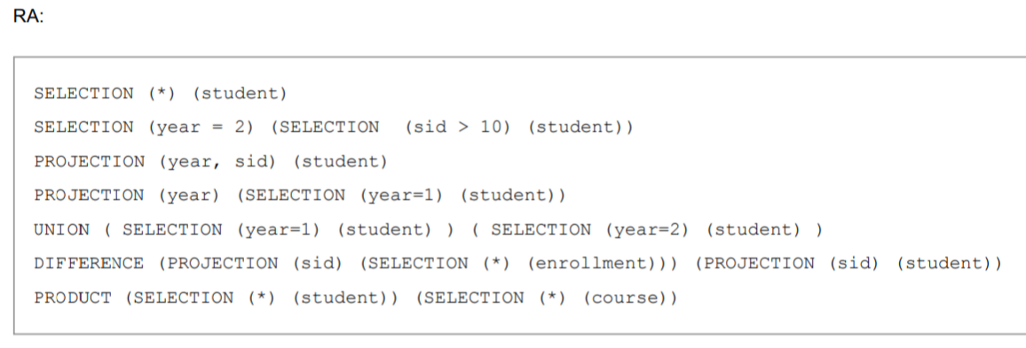
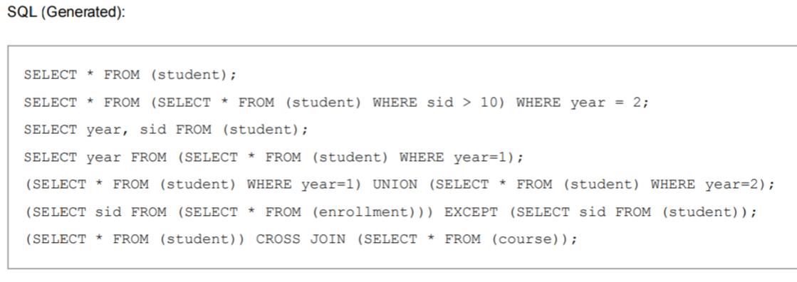
Results

Slide 9
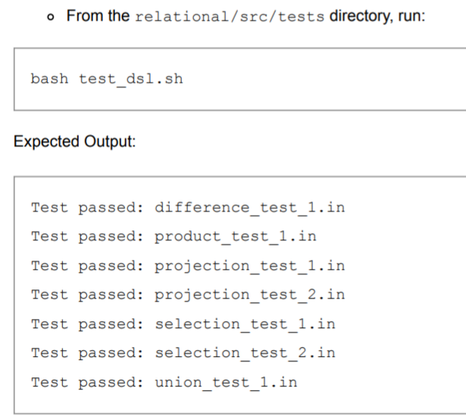
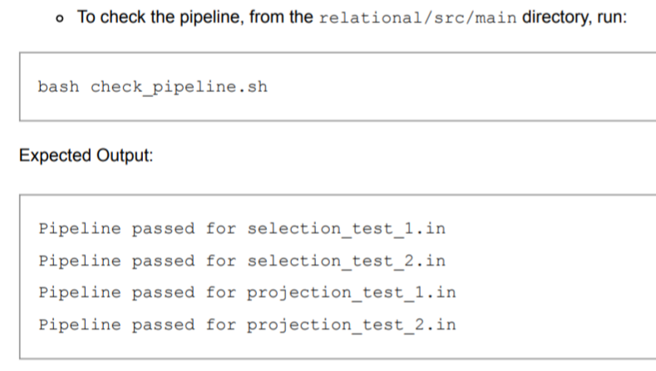
Testing
* Used bash scripts to run the application against custom testcases for the DSL.
* Checked error-free execution of the pipeline with SurrealDB for supported operations.

Slide 10
Future Scope
* Current implementation has redundancies in the generated SQL queries.
* A custom Interpreter is implemented, we can use Lark's Transformer module instead to make it more extensible.

Slide 11
Challenges
* Familiarization with SurrealDB syntax. SurrealDB does not follow typical DML syntax.
* Deciding on the right tool (PLY vs Lark vs PyParsing) - testing them and familiarization with Lark finally.
* Debugging. Debugging specific issues on the tree was challenging due to feast-or-famine of logging information.

Slide 12
References
* https://www.doc.ic.ac.uk/~pjm/teaching/student_projects/gc106_report.pdf
* https://lark-parser.readthedocs.io/en/latest/examples/index.html
* https://blog.erezsh.com/how-to-write-a-dsl-in-python-with-lark/
* https://gist.github.com/PH111P/7c8b529c0293d8c35adc#file-relalgsql-hs
* https://surrealdb.com/docs/surrealdb/introduction

